Slide 1



University Institute of Engineering
DEPARTMENT OF COMPUTER SCIENCE & ENGINEERING
Subject Name: Software Engineering
Subject Code: 23CST-206
Er. Jagmeet Kaur
E8387
ASSISTANT PROFESSOR
CSE
DISCOVER . LEARN . EMPOWER

Slide 2
Introduction to Software Engineering
Course Outcome
CO Number | Title | Level
CO1 | Analyze the basic knowledge in software engineering to learn the various software development process models. | Understand

Slide 3
Chapter-1 Topics covered
Definition of software and Software engineering
Need of Software engineering
Objectives of Software engineering
Software Development Life Cycle

Slide 4
Software
Software is a program or set of programs containing instructions which provide desired functionality .
The software is collection of Integrated programs.
Software consists of carefully-organized instructions and code written by programmers in any of various special computer languages.
Computer programs and associated documentation such as requirements, design models and user manuals.

Slide 5
Dual Role of Software
1. As a product –
It delivers the computing potential across network of Hardware.
It enables the Hardware to deliver the expected functionality.
It acts as information transformer because it produces, manages, acquires, modifies, displays, or transmits information.
2. As a vehicle for delivering a product –
It provides system functionality
It controls other software
It helps build other software

Slide 6
Program vs. Software
Program is a set of instruction related each other where as Software Product is a collection of program designed for specific task.
Programs are usually small in size where as Software Products are usually large in size.
Programs are developed by individuals that means single user where as Software Product are developed by large no of users.
In program, there is no documentation or lack in proper documentation whereas in Software Product, Proper documentation and well documented and user manual prepared.

Slide 7
Program vs. Software
Development of program is Unplanned, usually not Systematic etc but Development of Software Product is well Systematic, organized, planned approach.
Programs provide Limited functionality and less features where as Software Products provides more functionality as they are big in size more options and features.

Slide 8
Software Engineering
Software Engineering is a systematic approach to the design, development, operation, and maintenance of a software system.
Software engineering is an engineering discipline that’s applied to the development of software in a systematic approach
It’s the application of theories, methods, and tools to design build a software that meets the specifications, cost, and ensures quality.

Slide 9
Software Engineering
It is not only concerned with the technical process of building a software, it also includes activities to manage the project, develop tools, methods and theories that support the software production.
Not applying software engineering methods results in more expensive, less reliable software, and it can be vital on the long term, as the changes come in, the costs will dramatically increase.
Different methods and techniques of software engineering are appropriate for different types of systems.
For example, games should be developed using series of prototypes, while critical control systems require a complete analyzable specification to be developed.

Slide 10
Objectives of Software Engineering
Maintainability – the ease with which changes in a functional unit can be performed in order to meet prescribed requirements.
Correctness – the extent to which software meets its specified requirements
Reusability – the extent to which a module can be used in multiple applications.
Testability – the extent to which software facilitates both the establishment of test criteria and the evaluation of the software with respect to those criteria.

Slide 11
Objectives of Software Engineering
Reliability – an attribute of software quality. The extent to which a program can be expected to perform its intended function, over an arbitrary time period.
Portability – the ease with which software can be transferred from one computer system or environment to another.
Adaptability – the ease with which software allows differing system constraints and user needs to be satisfied by making changes to the software.

Slide 12
Need of Software Engineering
Software Engineering is required due to the following reasons:
To manage Large software
For more Scalability
Cost Management
To manage the dynamic nature of software
For better quality Management

Slide 13
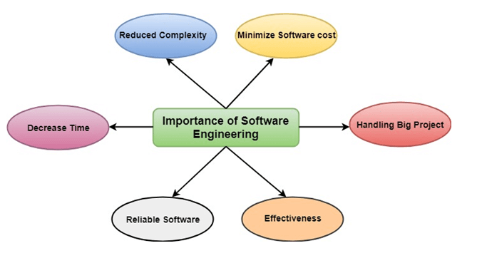
Importance of Software Engineering
Fig 1 Importance of Software Engineering

Slide 14
Importance of Software Engineering
Reduces complexity
Software engineering has a great solution to reduce the complication of any project.
Software engineering divides big problems into various small issues.
And then start solving each small issue one by one. All these small problems are solved independently to each other.

Slide 15
Importance of Software Engineering
To minimize software cost:
Software needs a lot of hardwork and software engineers are highly paid experts.
But using software engineering, programmers project everything and decrease all those things that are not needed.
In turn, the cost for software productions becomes less as compared to any software that does not use software engineering method.

Slide 16
Importance of Software Engineering
To decrease time:
To achieve the requirements of the software, many codes are executed to reach the definite running code.
This is a very time-consuming procedure, and if it is not well handled, then this can take a lot of time.
So if you are making your software according to the software engineering method, then it will decrease a lot of time.

Slide 17
Importance of Software Engineering
Handling big projects:
Big projects are not done in a couple of days, and they need lots of patience, planning, and management.
And to invest many months of any company, it requires heaps of planning, direction, testing, and maintenance.
The company has provided many resources to the plan and it should be completed well in time.
So to handle a big project without any problem, the company has to go for a software engineering method.

Slide 18
Importance of Software Engineering
Reliable software:
Software should be secure, means if you have delivered the software, then it should work for at least its given time or subscription.
And if any bugs come in the software, the company is responsible for solving all these bugs.
Because in software engineering, testing and maintenance are given, so there is no worry of its reliability.

Slide 19
Importance of Software Engineering
Effectiveness:
Effectiveness comes if anything has made according to the standards.
Software standards are the big target of companies to make it more effective.
So Software becomes more effective in the act with the help of software engineering.

Slide 20
Software Development Life Cycle
Software Development Life Cycle (SDLC) is a process used by the software industry to design, develop and test high quality software.
The SDLC aims to produce a high-quality software that meets or exceeds customer expectations, reaches completion within times and cost estimates.
The life cycle defines a methodology for improving the quality of software and the overall development process.
It consists of a detailed plan describing how to develop, maintain, replace and alter or enhance specific software.

Slide 21
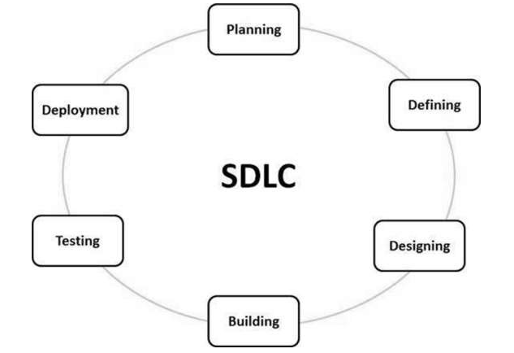
Software Development Life Cycle
Fig 2 Software Development Life Cycle

Slide 22
Stage 1: Requirement Analysis
Requirement analysis is the most important and fundamental stage in SDLC.
It is performed by the senior members of the team with inputs from the customer, the sales department, market surveys and domain experts in the industry.
The information is then used to plan the basic project approach and to conduct product feasibility study in the economical, operational and technical areas.
The outcome of the technical feasibility study defines various approaches that can be followed to implement the project successfully with minimum risks.

Slide 23
Stage 2: Defining Requirements
Once the requirement analysis is done the next step is to clearly define and document the product requirements and get them approved from the customer or the market analysts.
This is done through an SRS (Software Requirement Specification) document which consists of all the product requirements to be designed and developed during the project life cycle

Slide 24
Stage 3: Designing the Product Architecture
Based on the requirements specified in SRS, usually more than one design approach for the product architecture is proposed and documented in a Design Document Specification (DDS).
DDS is reviewed by all the important stakeholders and based on various parameters as risk assessment, product robustness, design modularity, budget and time constraints, the best design approach is selected for the product.
A design approach clearly defines all the architectural modules of the product along with its communication and data flow representation with the external and third party modules.

Slide 25
Stage 4: Building or Developing the Product
In this stage of SDLC the actual development starts and the product is built.
The programming code is generated as per DDS during this stage.
If the design is performed in a detailed and organized manner, code generation can be accomplished without much hassle.

Slide 26
Stage 4: Building or Developing the Product
Developers must follow the coding guidelines defined by their organization and programming tools like compilers, interpreters, debuggers, etc. are used to generate the code.
Different high level programming languages such as C, C++, Pascal, Java and PHP are used for coding.
The programming language is chosen with respect to the type of software being developed.

Slide 27
Stage 5: Testing the Product
This stage is usually a subset of all the stages as in the modern SDLC models, the testing activities are mostly involved in all the stages of SDLC.
However, this stage refers to the testing only stage of the product where product defects are reported, tracked, fixed and retested, until the product reaches the quality standards defined in the SRS.

Slide 28
Stage 6: Deployment in the Market and Maintenance
Once the product is tested and ready to be deployed it is released formally in the appropriate market.
Sometimes product deployment happens in stages as per the business strategy of that organization.
The product may first be released in a limited segment and tested in the real business environment (UAT- User acceptance testing).

Slide 29
Stage 6: Deployment in the Market and Maintenance
Then based on the feedback, the product may be released as it is or with suggested enhancements in the targeting market segment.
After the product is released in the market, its maintenance is done for the existing customer base.

Slide 30
References
https://nptel.ac.in/courses/106/105/106105182/
https://www.tutorialspoint.com/software_engineering/index.htm
https://www.javatpoint.com/software-engineering-tutorial
https://www.tutorialride.com/software-engineering/software-engineering-tutorial.htm
https://tutorialsinhand.com/tutorials/software-engineering-tutorial/software-engineering-introduction/software-engineering-home.aspx

Slide 31
Image References
Fig 1 https://www.tutorialspoint.com/software_engineering/index.htm
Fig 2
https://www.tutorialride.com/software-engineering/software-engineering-tutorial.htm

Slide 32
THANK YOU

